Slide 1
Uninformed/Blind Search
BBM 405 – Fundamentals of Artificial Intelligence
Pinar Duygulu
Hacettepe University
Slides are mostly adapted from AIMA, MIT Open Courseware,
Manuela Veloso(CMU) and
Svetlana Lazebnik (UIUC)

Slide 2
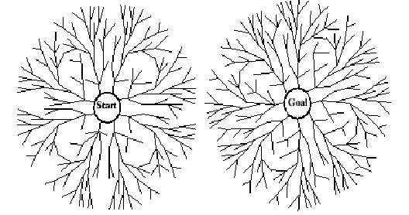
Bidirectional search
Run two simultaneous searches – one forward from the initial state, and the other backward from the goal, stopping when two searches meet in the middle
b^{d/2} + b^{d/2} < b^{d}
For b = 10, d= 6 , BFS 1,111, 111 nodes, BS 2,222 nodes
Notes:
We have seen methods to go from the start state to the goal state
We can do a bidirectional search which searches forward from start to the goal state and also backward from goal to start state,.
And stops when two searches meet in the middle
When the brachning factor is large bidirectional search can make a big difference
Because if there is a solution at depth d, instead of O(b^d) we will have a complexity O(2xb^d/2), which is much less
For example for b=10 and d=6 breadth first search generates 1,111,111 nodes
Whereas bidirectional generates only 2.222 nodes

Slide 3
Bi-directional Search discussion
Need to have operators that calculate predecessors.
• Need a way to check that states meet (are the same)
• Efficient way to check when searches meet: hash table
• Can use IDS or BFS or DFS in each half
Optimal, complete, O(b^{d/2}) time.
Still O(b^{d/2}) space (even with iterative deepening) because the nodes of at least one of the searches have to be stored to check matches.
Notes:
In order to implement the backward search we have to keep a list of predecessors similar to successors.
Predecessors of a node n are all the nodes that have n as a successor
When all operators are reversible it is easy to find predecessor set which is identical to successor set
However, in some problems it may be very difficult
When there are many possible goal states, in the case of explicit list of goal states we can apply the predecessor function to all the goals.
But if we only have a description of the goal, like the checkmate goal in chess, it may be more difficult
To efficiently check whether a node had already been in the search tree of the other half, we can use hash tables.
You can also use DFS or IDS in each half instead of BFS
In order for two searches to meet, the nodes of at least one of them must all be retained in the memory even with the other search strategies
Therefore the space complexity will be O(b^d/2) for the other strategies as well

Slide 4
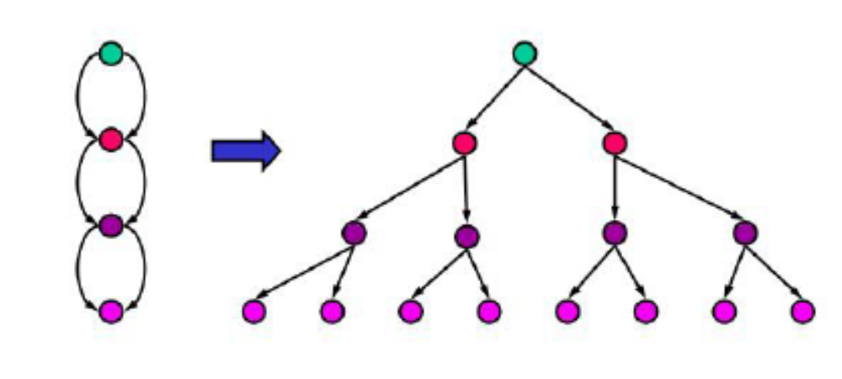
Repeated states
Failure to detect repeated states can turn a linear problem into an exponential one!
Notes:
It is important not to waste time by expanding states that have already been encountered and expanded before on some other path
For the problems like route finding, repeated states are unavoidable since the operators are reversible
The search trees are thus infinite
By pruning some of the repeated states we can cut down the search tree to a finite size
This example shows one of the extreme cases with exponential growth
Although it has only m+1 states with m being the maximum depth it has 2^m branches

Slide 5
Handling repeated states
Do not return to the state just you came from
Do not create paths with cycles in them
Do not generate any state that was ever generated before
Notes:
Do not return to the state just you came from
Expand function should refuse to generate any successor that is the same as the node’s parent
Do not create paths with cycles in them
The expand function should refuse to generate a successor of a node that is the same as any of the node’s ancestors
Do not generate any state that was ever generated before
This requires every generated state to be kept in the memory
For the last one it is better to use a hash table to store all the generated nodes

Slide 6
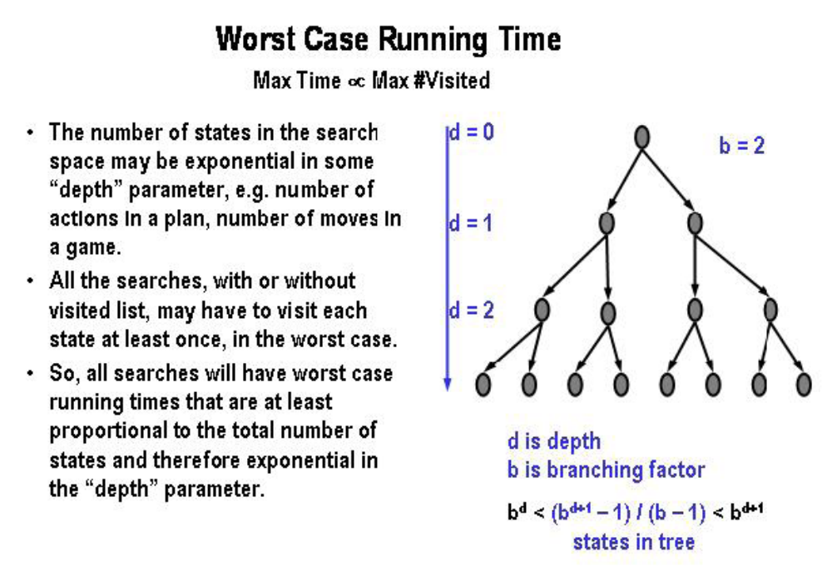
Notes:
Even if we use a repeated or visited nodes list
In the worst case we have to visit each state at least once
Consider the example with breadth first search
We expand all the nodes at level 2
We may find the goal state as the first node on level 3 or in the worst case as the last node level 3
Therefore our complexity will be between b^d and b^d+1
The worst case time complexity is the same in depth first search as well

Slide 7
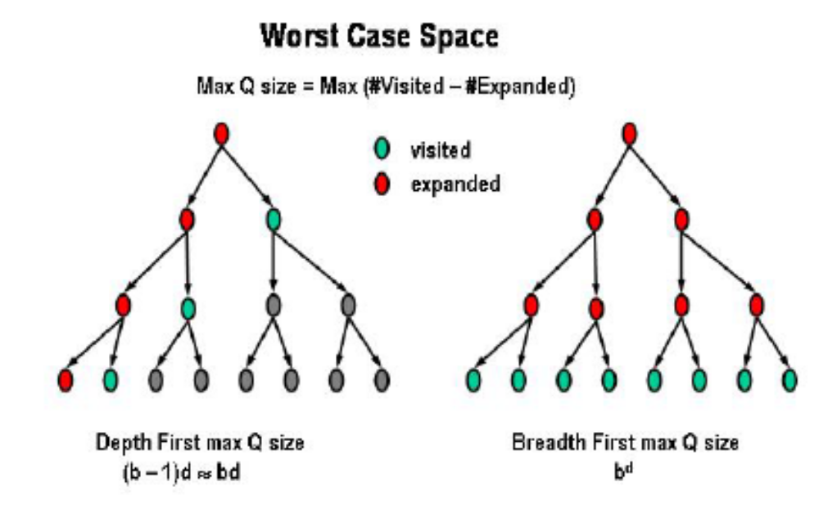
Notes:
However, when we look at the space complexity
Although breadth first requires all the nodes to be kept in memory
With depth first search we will only keep visited yet not expanded nodes additionally

Slide 8
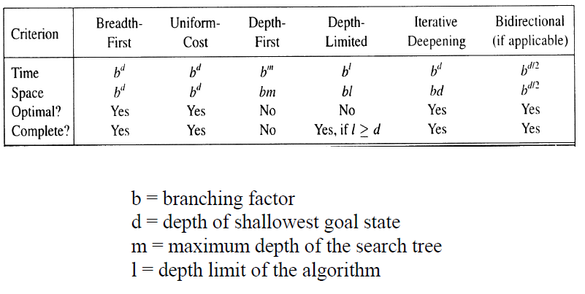
Summary
Problem formulation usually requires abstracting away real-world details to define a state space that can feasibly be explored
Variety of uninformed search strategies
Iterative deepening search uses only linear space and not much more time than other uninformed algorithms

Slide 9
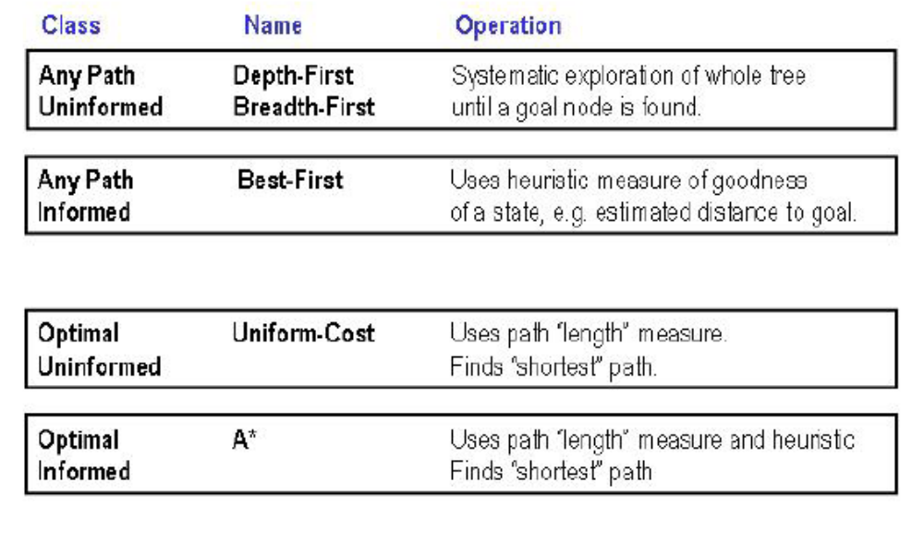
Classes of Search

